Slide 1


SRM Institute Of Science And Technology
PRESENTATION
Secure Surfing
NAME :- GAURAV GUPTA
BRANCH :- Btech CSE specialization
(AI & ML)
DEPATMENT :- CINTEL
SUBJECT :- Advanced Programming Practice
REG. NO. :- 2211026010284

Slide 2

Content
introduction
Problem statement
Modules Used (Java & python)
workflow
Screenshots (java & python)

Slide 3
Introduction
This project is a web application designed for secure web link authenticity checking. It combines front-end HTML and CSS with a Flask-based Python and JAVA back-end. Users can enter web links, and the application will check their authenticity by making HTTP requests to the provided URLs. The results are displayed on the web page, and entries are logged in a MySQL database, allowing users to track the history of checked links. Additionally, users can create new credentials for login, although this aspect is simplified for demonstration purposes. This project showcases how to create a basic web application for link checking and database integration.

Slide 4
Problem Statement

Slide 5
Problem Statement
In a digital era where online security is paramount, the Secure Surfing project aims to create a user authentication and website security checker application. Users need a robust and user-friendly solution for registering, securely accessing the application, and checking the safety of websites they visit, thereby enhancing their online security and privacy.

Slide 6
Modules used

Slide 7
Modules Used
Javax.swing
Java.awt
Java.awt.event
Java.io.IOException
Java.net.HttpURLConnection
java.sql
Javax.imageio.ImagIO
Java.util
MySQL Database

Slide 8
*Javax.swing* These packages are part of Java's Swing library, used to create graphical user interfaces (GUI) for your application.
*java.awt*:
The Abstract Window Toolkit (AWT) is used for creating graphical user interfaces in Java, including components like labels, text fields, and buttons.
*java.awt.event*: These packages provide classes for handling various events like button clicks and mouse actions in the AWT and Swing components.

Slide 9
*java.io.IOException*: This class is used to handle exceptions related to input and output operations, although it appears to be unused in the provided code.
*Java.net.HttpURLConnection* :
These classes are used to check the status of websites by creating HTTP connections and parsing URIs.
*java.sql*:
These packages are used for interacting with a MySQL database, including establishing connections, executing SQL queries, and managing database tables.

Slide 10
*javax.imageio.ImageIO* This library is used to load image resources like the "eye.png" icon for the password visibility toggle.
* java.util *:
The java.util package provides utility classes and data structures for dealing with collections and other general-purpose operations.
*MySQL Database*:
Your code interacts with a MySQL database using JDBC (Java Database Connectivity). You establish connections, create tables, and execute SQL queries for user authentication and website status storage.

Slide 11
Modules Used
CSS Styling
Container Structure
Forms
Java Script
Python Flask
MySQL Database
Routes
HTTP Requests

Slide 12
CSS Styling:
Defines the styling for various elements on the web page, including fonts, colors, layout, and buttons.
Container Structure:
Divides the page into two columns using the .container, .left-column, and .right-column classes.
left-column: Displays a background image.
right-column: Contains the main content and forms for login and link checking.
Forms:
The HTML forms are used to collect user input:
Login Form: Contains input fields for username and password.
Link Checker Form: Used to check the authenticity of web links.

Slide 13
Java Script:
Includes JavaScript code for handling user interactions and form submissions. This code validates login credentials, handles user creation, and simulates link authenticity checking.
Python Flask:
A Python web framework used to create the web application.
MySQL Database:
The code integrates with a MySQL database:
It connects to the MySQL server.
It creates a database called "appproject" if it doesn't exist.
It uses the "appproject" database.
It creates a table named "History" with columns for website URLs and entry timestamps.

Slide 14
Routes:
/: The root route, both for GET and POST requests.
Handles form submissions when a user enters web links to check their authenticity.
Makes HTTP requests to the provided URLs, captures the HTTP status codes, and logs entries in the database.
Removes duplicate entries in the database, leaving only the latest entry for each unique URL.
HTTP Requests:
The code uses the requests library to send HTTP GET requests to the provided web links and capture the status code in response.

Slide 15
Workflow

Slide 16
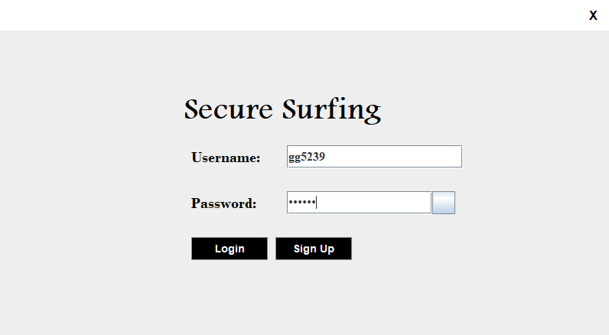
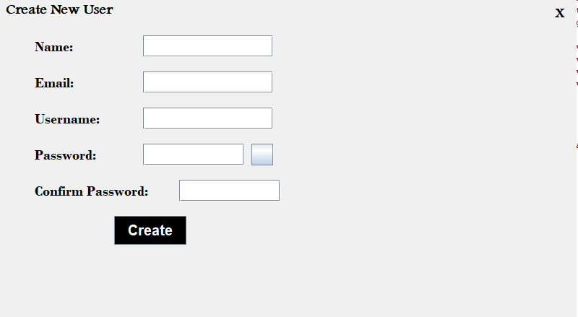
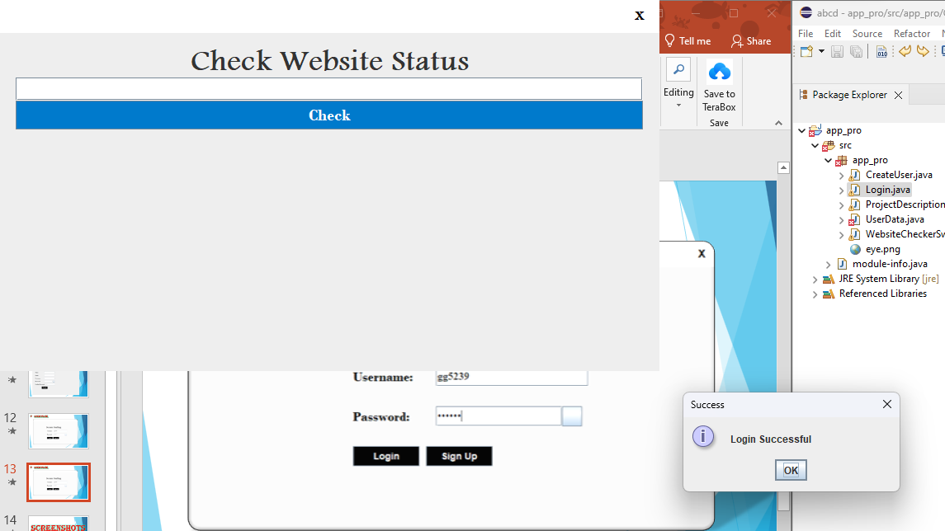
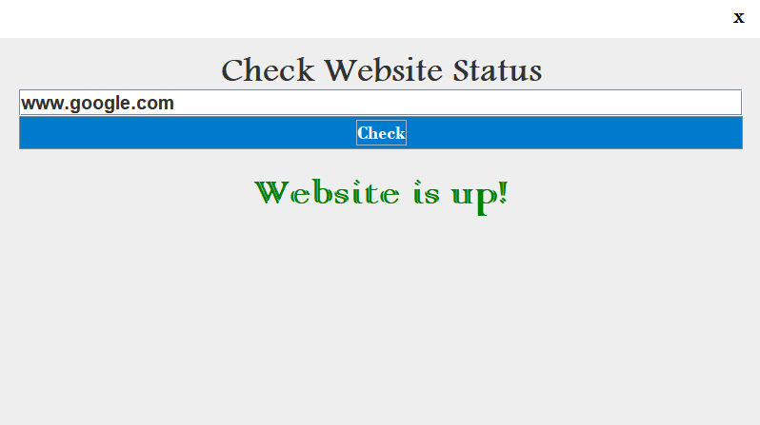
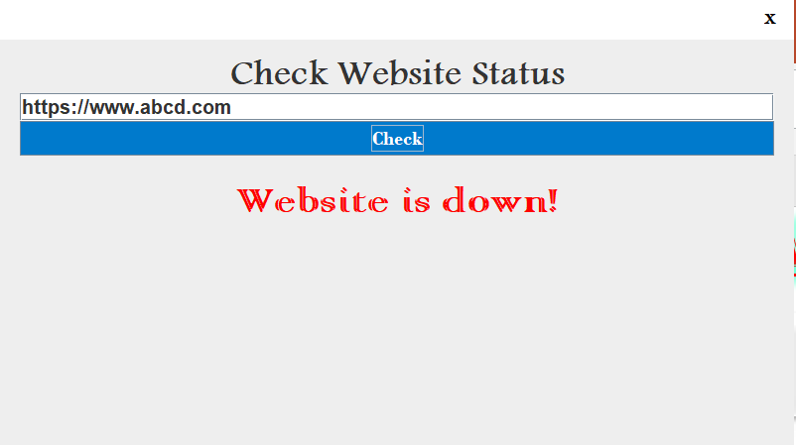
Workflow
Login Page
Login or Signup
If user does not exists
If user exists enter login credentials
Create User window
Website checker
page
Result shown website up/down

Slide 17
ScreenShots

Slide 18
ScreenShots java

Slide 19
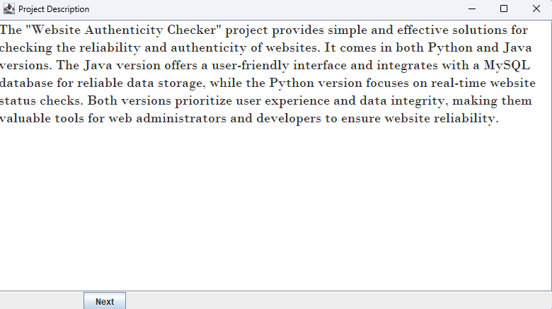
Project Description

Slide 20
Create User

Slide 21
Login page

Slide 22
Login page

Slide 23
Login successful

Slide 24
Checking for website status

Slide 25
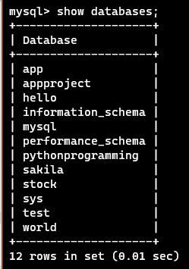
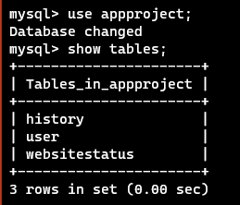
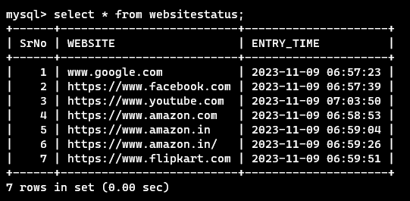
database

Slide 26
ScreenShots python

Slide 27
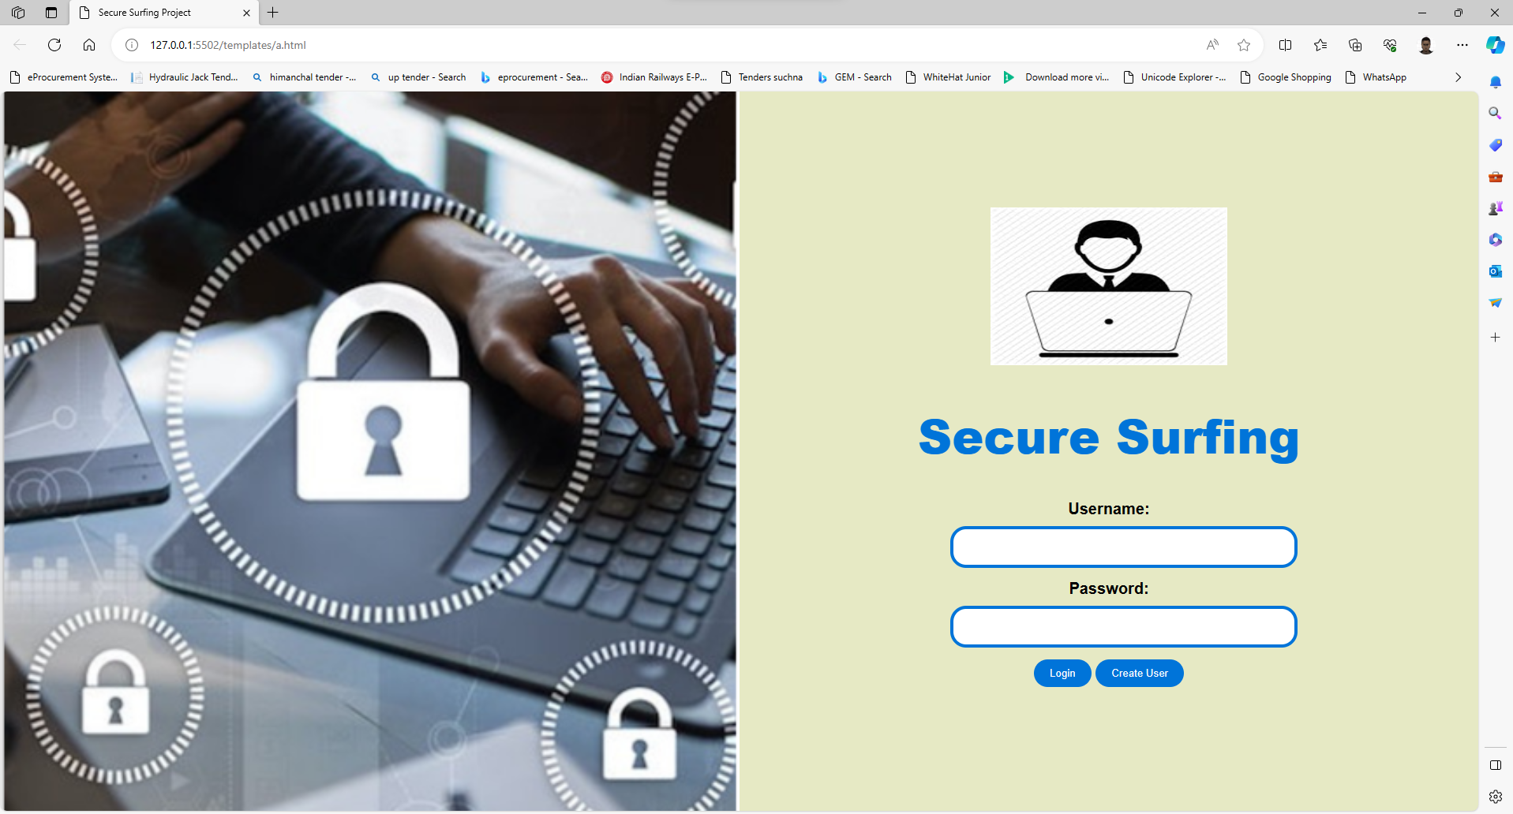
Home page

Slide 28
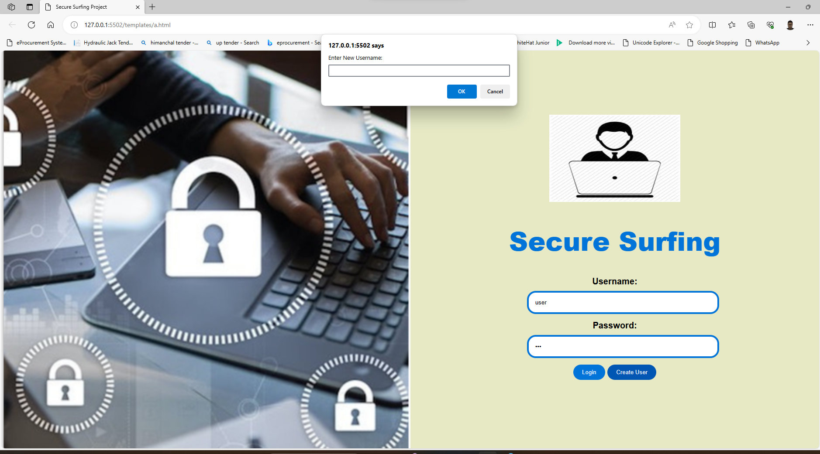
Create User box

Slide 29

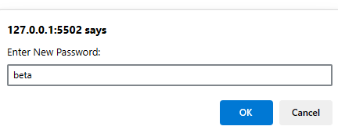
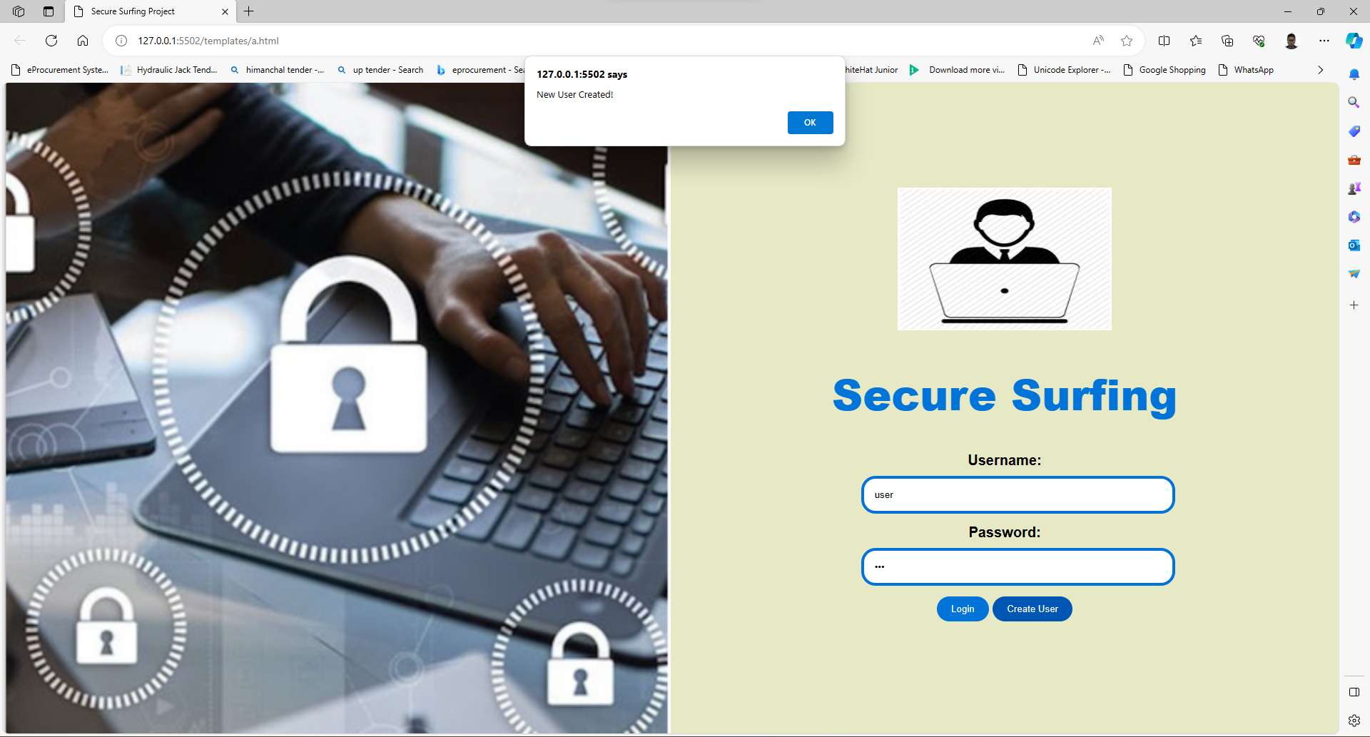
Entering Username and password
Enter Username
Enter Password
User Created

Slide 30
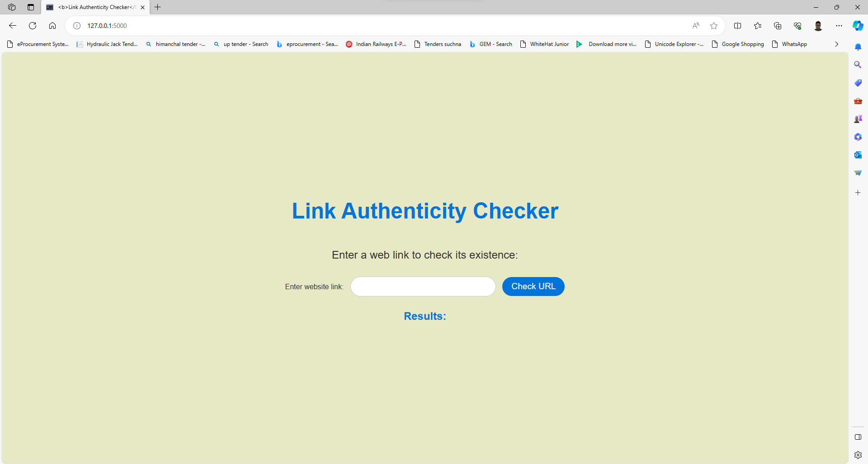
Authenticity checker page

Slide 31
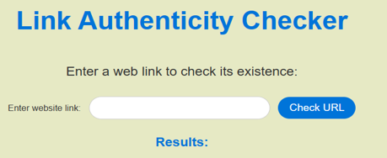
Authenticity checker page
Enter your weblink in the white box to check its authenticity

Slide 32
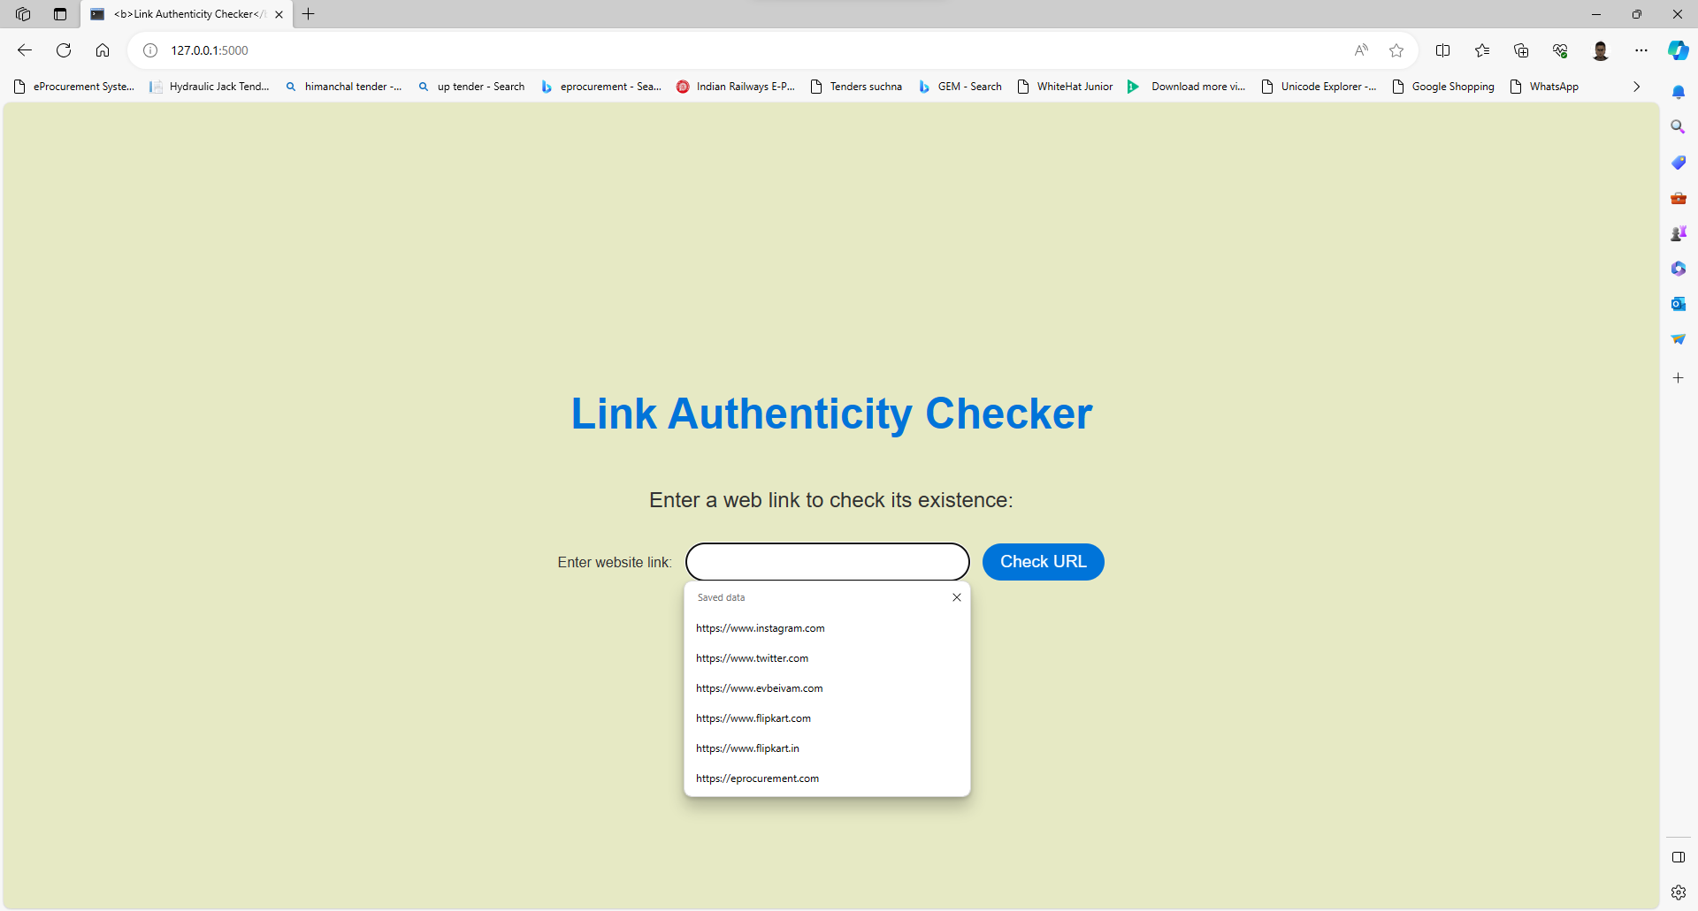
Some already checked websites

Slide 33
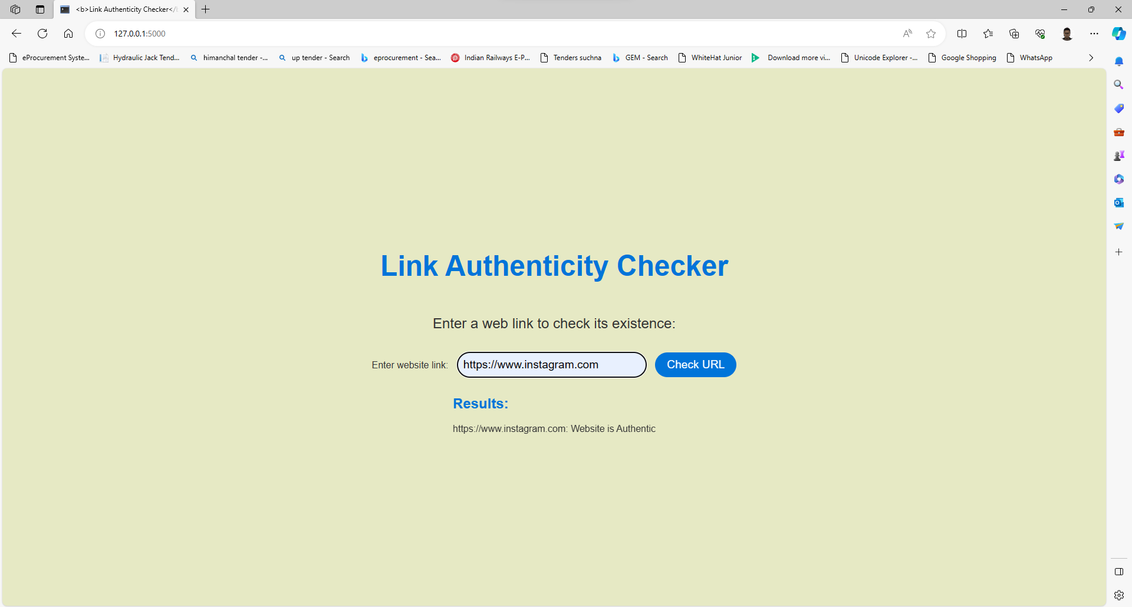
Result – authentic or not
Enter the URL
Result

Slide 34
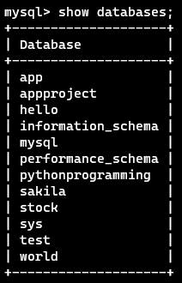
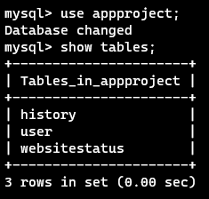
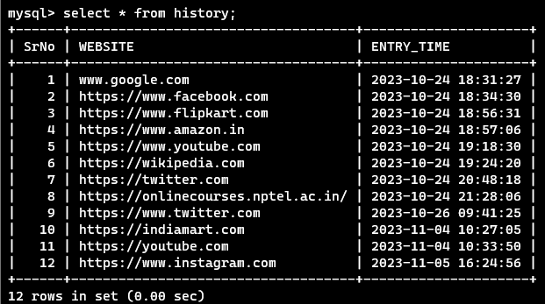
Databse output

Slide 35
Conclusion
In conclusion, this project successfully combines front-end and back-end technologies to create a web application for checking the authenticity of web links. It showcases the capabilities of Flask, MySQL, HTML, and CSS, providing users with a user-friendly interface and storing link history in a database. This project serves as a foundation for more advanced features and security enhancements and offers valuable insights for web development and database management.

